Slide 1


Sitting Posture Corrector App on Raspberry Pi Using Edge AI
ACM India Winter School on Edge AI – Hackathon Project
Pranav MR – BITS Goa
pranavmr0402@gmail.com
Shreyas Sankaran – BITS Goa
iamshreyas08@gmail.com
Ashwin Prashant Hariharan – IIT Madras
24f3100099@es.study.iitm.ac.in
Ronalda M – NIT Srinagar
ronalda_2022phacse005@nitsri.ac.in
Veningston K – NIT Srinagar
veningstonk@nitsri.ac.in
dia
EdgeAI Posture Corrector

Slide 2
Problem
Works on-device
Single camera in a side view.
MoveNet (TFLite) estimates 17 body keypoints in real time.
A calibrated scoring module maps posture deviation to Score ∈ [0, 100]. Raises warning to indicate Good / Bad posture.
Moreover, we also suggest the reason for the bad posture to help identify corrective measures.
dia
EdgeAI Posture Corrector

Slide 3
Problem
Posture refers to the natural way one holds their body.
In this project, we are analyzing desk posture, specifically through 2 parameters,
1
2
Neck Slouch Torso Slouch
through a side view camera and a Raspberry Pi.
Goal: Detect sitting posture in real time and provide actionable feedback using a 0–100 score and warning.
We also aim to track Focus Time and Idle Time and alert the user about the same.
dia
EdgeAI Posture Corrector

Slide 4
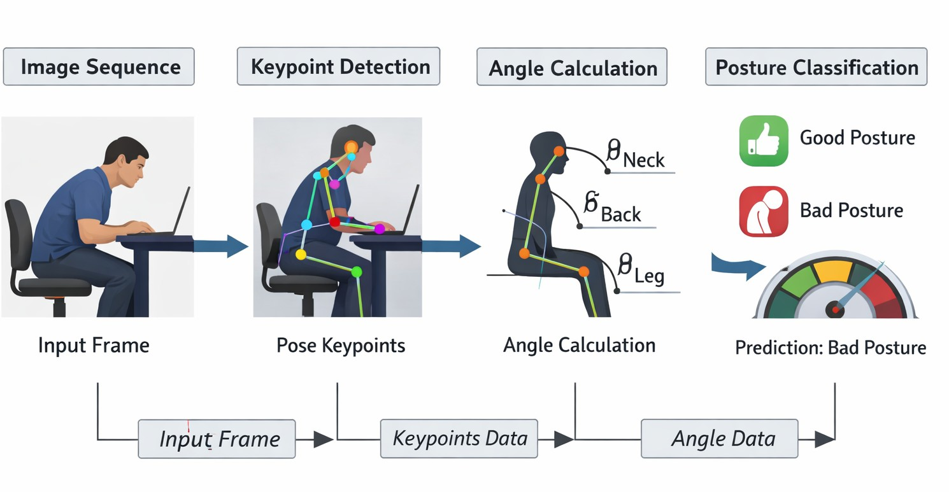
System Overview
Figure 1: End-to-end pipeline for posture monitoring in side view: input video frames → MoveNet keypoint extraction → angle computation → posture prediction and score visualization.
dia
EdgeAI Posture Corrector

Slide 5
Hardware & Deployment
Edge device: Raspberry Pi (camera)
Compute: On-device inference with tflite runtime
Privacy: Video stays local; only score/warning output leaves the pipeline
dia
EdgeAI Posture Corrector

Slide 6
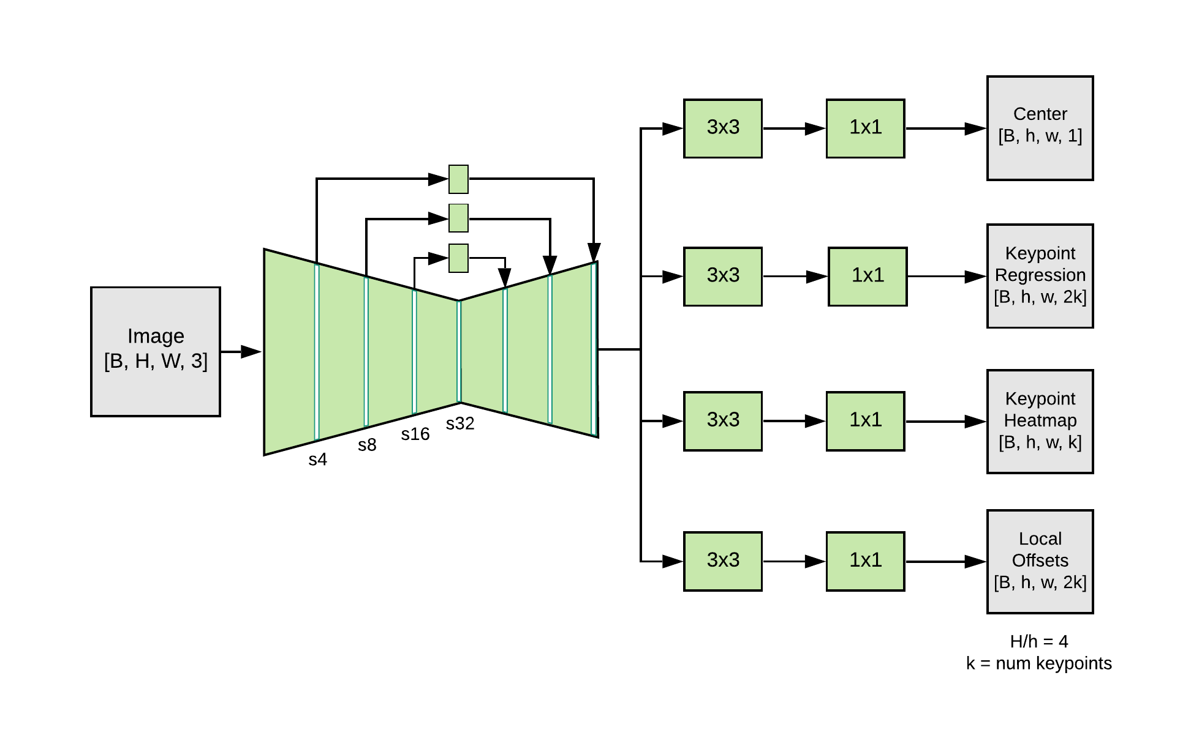
Pose Estimation with MoveNet
MoveNet outputs keypoints
KP = {(x_{i} , y_{i} , c_{i} }¹⁷
i =1
where, x_{i} , y_{i} , c_{i} are normalized coordinates and confidence. Interest points from head, shoulder, hip.
Figure 2: MoveNet Architecture
dia
EdgeAI Posture Corrector

Slide 7
Calibration & Scoring Configuration [1/3]
Runtime & Keypoint Settings
Frame resolution: 640×480, frame rate: 30 FPS
Minimum keypoint confidence: c_{min} = 0.3 (ignore low-confidence joints) Time scaling for testing: TIME RATE = 30.0 (accelerated evaluation)
Bad posture alert after sustained deviation: 10 s Idle alert after continuous sitting/standing: 30 min Focus session minimum duration: 5 min
Alert & Session Timing
dia
EdgeAI Posture Corrector

Slide 8
Calibration & Scoring Configuration [2/3]
Angle Calibration (Reference Ranges)
Neck angle (ear–shoulder–hip):
NECK MIN = 130◦, NECK OPT = 180◦, NECK MAX = 200◦
Torso angle (shoulder–hip–knee):
TORSO MIN = 45◦, TORSO OPT = 90◦, TORSO MAX = 135◦
Degrees change to count as head movement
Movement-change thresholds (to detect activity):
∆θ_{head} ≥ 10◦, ∆θ_{leg} ≥ 10◦
dia
EdgeAI Posture Corrector

Slide 9
Calibration & Scoring Configuration [3/3]
Final Posture Score (0–100)
^{Score = W}neck ^{· S}neck ^{+ W}torso ^{· S}torso,
W_{neck} = 0.5, W_{torso} = 0.5
Good posture if Score ≥ 75
dia
EdgeAI Posture Corrector

Slide 10
Video Demo
dia
EdgeAI Posture Corrector

Slide 11
Algorithm Outline
Capture frame, preprocess to MoveNet input size. Run MoveNet inference → keypoints {(x_{i} , y_{i} , c_{i} )}.
Apply confidence gating; compute head/shoulder/hip and other midpoints. Extract angle features: neck flexion, torso slouch.
Drive ALERT based on Score and hold time.
1
2
3
4
5
dia
EdgeAI Posture Corrector

Slide 12
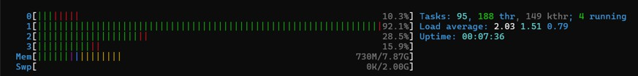
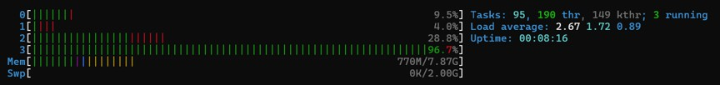
Resource Footprint (CPU & RAM)
Measure CPU utilization and RAM usage. Report peak RAM and average CPU load.
Figure 3: Memory Footprint (No Inference vs. With Inference)
dia
EdgeAI Posture Corrector

Slide 13
End-to-End Dataflow of the Mobile App
1
Periodic Activity Logging on RPi - The posture monitoring pipeline runs continuously to record activity log every 10 seconds and append locally to CSV files to enable lightweight storage and offline availability.
Flask server running on Rpi serves this data as JSON responses using an custom API.
The Flutter-based Mobile App periodically requests the JSON data over the local network (Wi-Fi/hotspot), parses the response, and visualizes user activity in a dashboard.
Posture score trends over time,
Good vs. bad posture duration summaries,
End-to-End Data Flow
2
3
4
Pose & Scoring (RPi) → CSV Logs (every 10s) → Flask API (JSON) → Mobile App → Dashboard
dia
EdgeAI Posture Corrector

Slide 14
Conclusion
EdgeAI posture corrector runs locally on Raspberry Pi with real-time feedback. Calibration enables robust scoring under a single camera view.
dia
EdgeAI Posture Corrector

Slide 15
Future Work
Multi-view posture estimation (for true 3D triangulation).
Upgrade from single-person MoveNet to a multi-person pose pipeline (detect persons →
run pose per ROI)
Expand classes (e.g., asymmetric sitting, phone neck).
dia
EdgeAI Posture Corrector
15 / 16

Slide 16
BBC News.
”Sitting straight ’bad for backs” (BBC News, 2006).
http://news.bbc.co.uk/2/hi/6187080.stm.
Yi-Lang Chen et. al.,
”Postural Variabilities Associated with the Most Comfortable Sitting Postures: A Preliminary Study”.
Healthcare (Basel), 6;9(12):1685, 2021.
https://doi.org/10.3390/healthcare9121685.
Yuri Kwon et. al.,
”The effect of sitting posture on the loads at cervico-thoracic and lumbosacral joints”.
Technol Health Care. 26(Suppl 1):409–418., 2018.
https://doi.org/10.3233/THC-174717.
Donald D et. al.,
”Sitting biomechanics Part I: Review of the Literature”.
Journal of Manipulative and Physiological Therapeutics, Vol 22(9), 594-609, 1999.
https://doi.org/10.1016/S0161-4754(99)70020-5.
dia
EdgeAI Posture Corrector
15 / 16

Slide 17
Oana-Ruxandra Stincel et. al.,
”Assessment of Forward Head Posture and Ergonomics in Young IT Professionals – Reasons to Worry?”.
Med Lav. 114(1), 2023.
https://doi.org/10.23749/mdl.v114i1.13600.
David A Titcomb et. al.,
”Evaluation of the Craniovertebral Angle in Standing versus Sitting Positions in Young Adults with and without Severe Forward Head Posture”.
Int J Exerc Sci. 17(1):73–85., 2024.
https://doi.org/10.70252/GDNN4363.
Dae-Hyun Kim et. al.,
”Neck Pain in Adults with Forward Head Posture: Effects of Craniovertebral Angle and Cervical Range of Motion”.
Osong Public Health Res Perspect. 9(6):309–313, 2024.
https://doi.org/10.24171/j.phrp.2018.9.6.04.
Physio-Pedia.
dia
EdgeAI Posture Corrector

Slide 18
”Craniovertebral angle”.
https://www.physio-pedia.com/Craniovertebral_angle.
dia
EdgeAI Posture Corrector
16 / 16

Slide 19
Thank you!
Questions?
dia
EdgeAI Posture Corrector
16 / 16

